Slide 1
MyBikeTraffic.com
A framework for traffic analysis using bicycle radar and video data
Brian Toone, current research (2018 – 2021)

Slide 2
November 20, 2017
Riding home from work
Co Rd 55, Sterrett

Slide 3
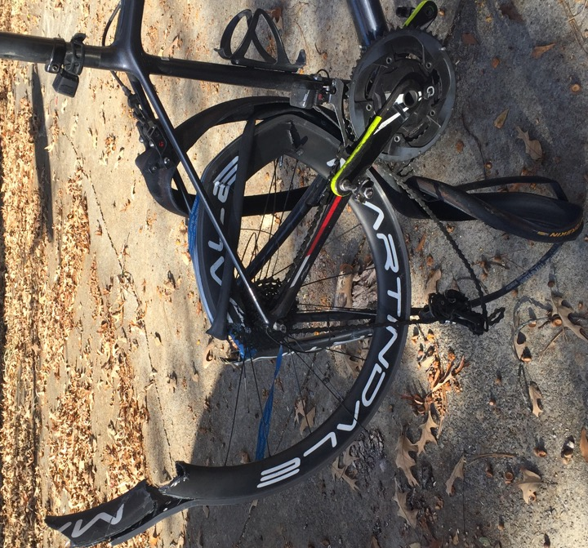
November 20, 2017
Riding home from work
Co Rd 55, Sterrett, Alabama
5 days in hospital, don’t remember much from first day

Slide 4
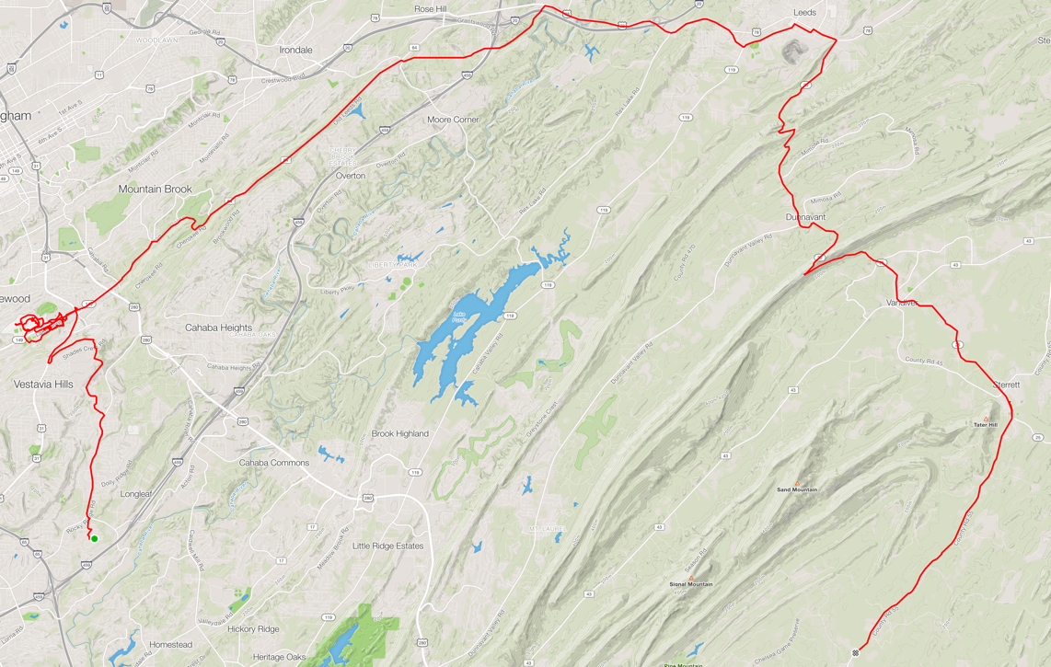

Slide 5
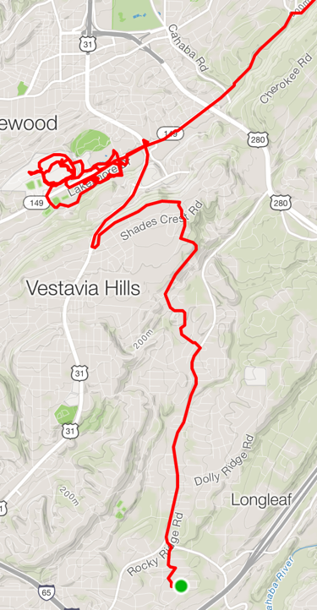
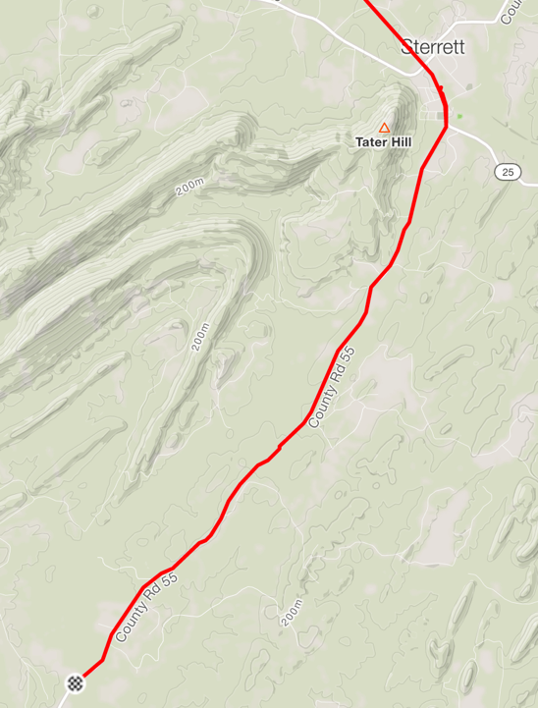

Slide 6
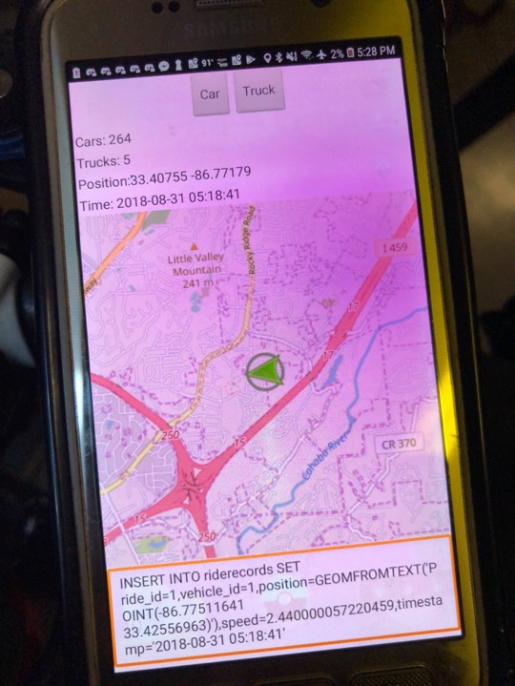
Project goal
Count the cars
Time-of-day traffic
analysis
Version 1.0

Slide 7
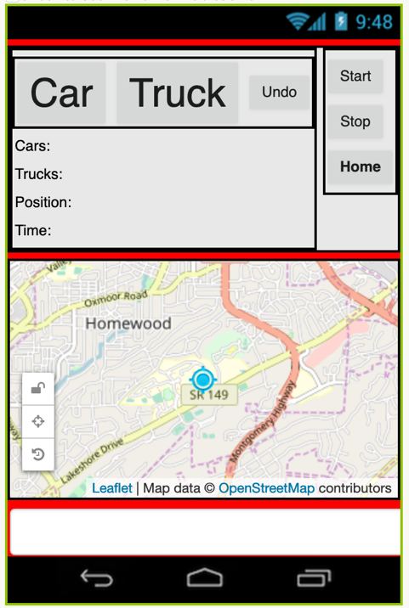
Version 2.0
Too difficult

Slide 8
Garmin Varia Radar
Rear taillight
Radar tracks cars
One dot per car

Slide 9
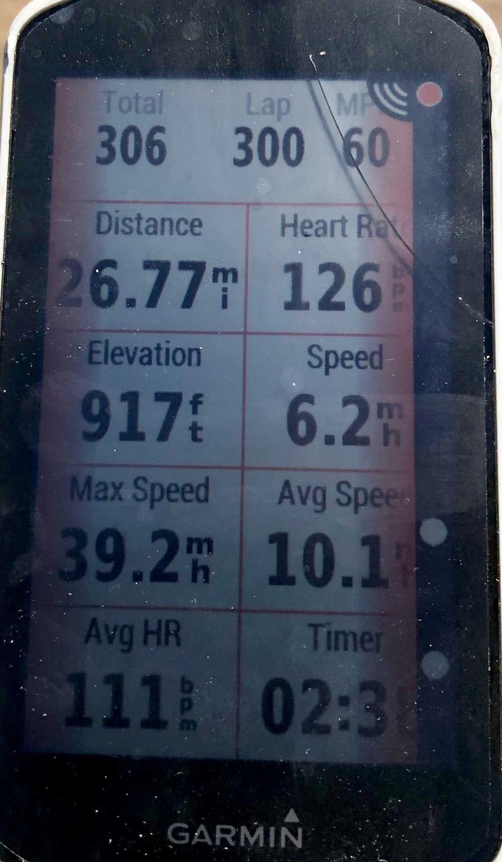
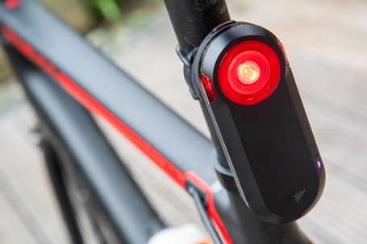
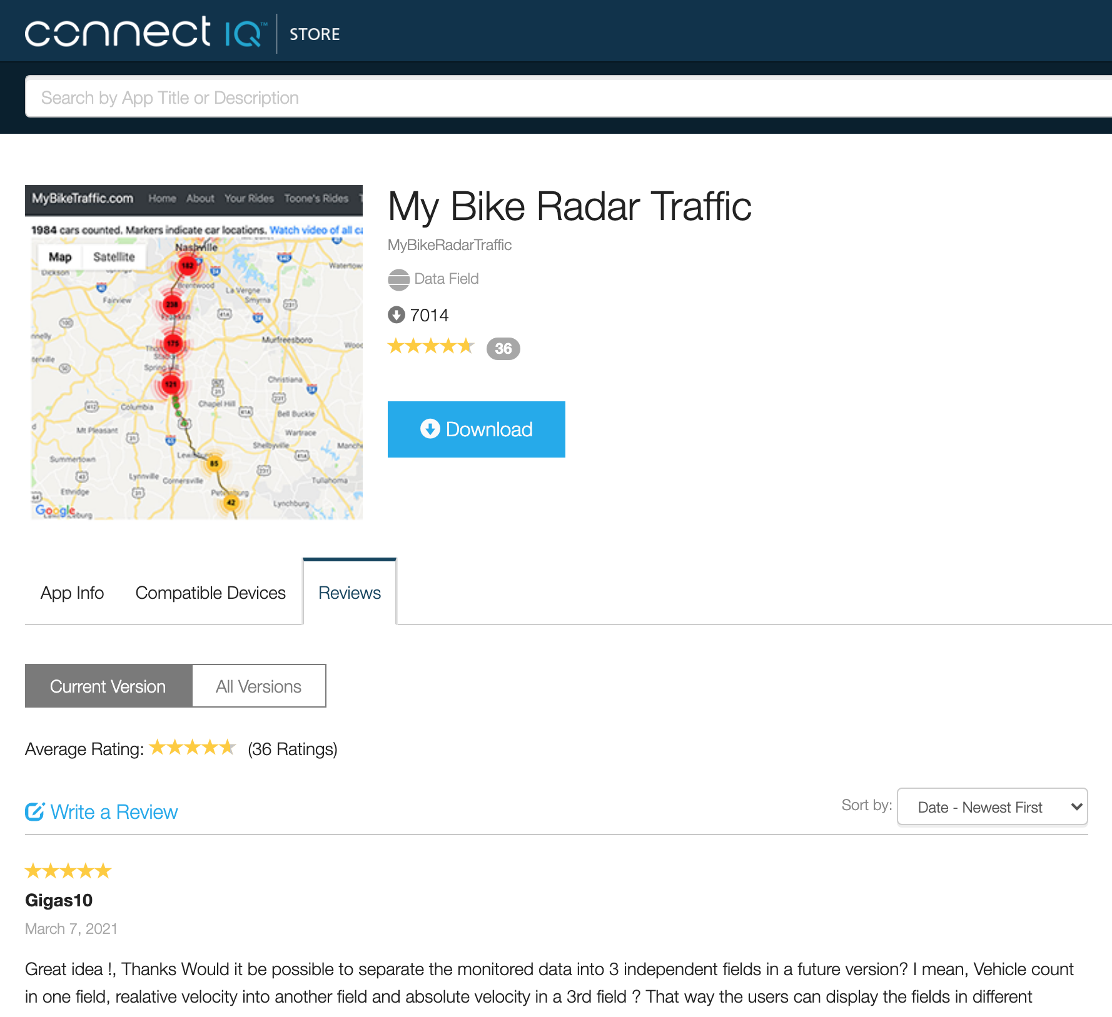
EQUIPMENT and SOFTWARE https://www.mybiketraffic.com/about/
Garmin 520+, 820, 1030
Garmin Varia Radar
ConnectIQ APP

Slide 10
Garmin Varia Radar
Connect IQ App
Install on newer Garmins … 520+, 820, 1030
Saves the data that is otherwise being thrown away

Slide 11
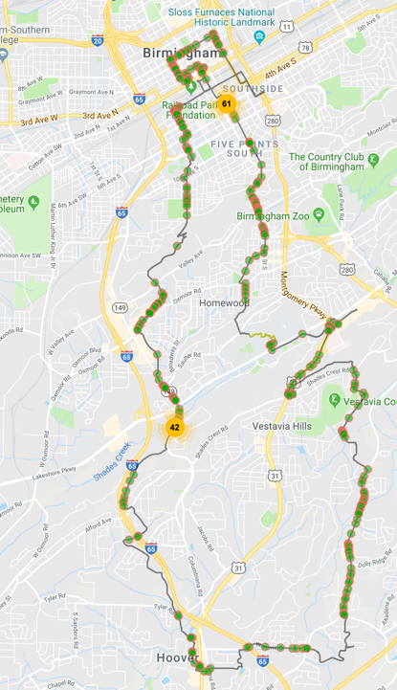
Viewing the data – mybiketraffic.com

Slide 12
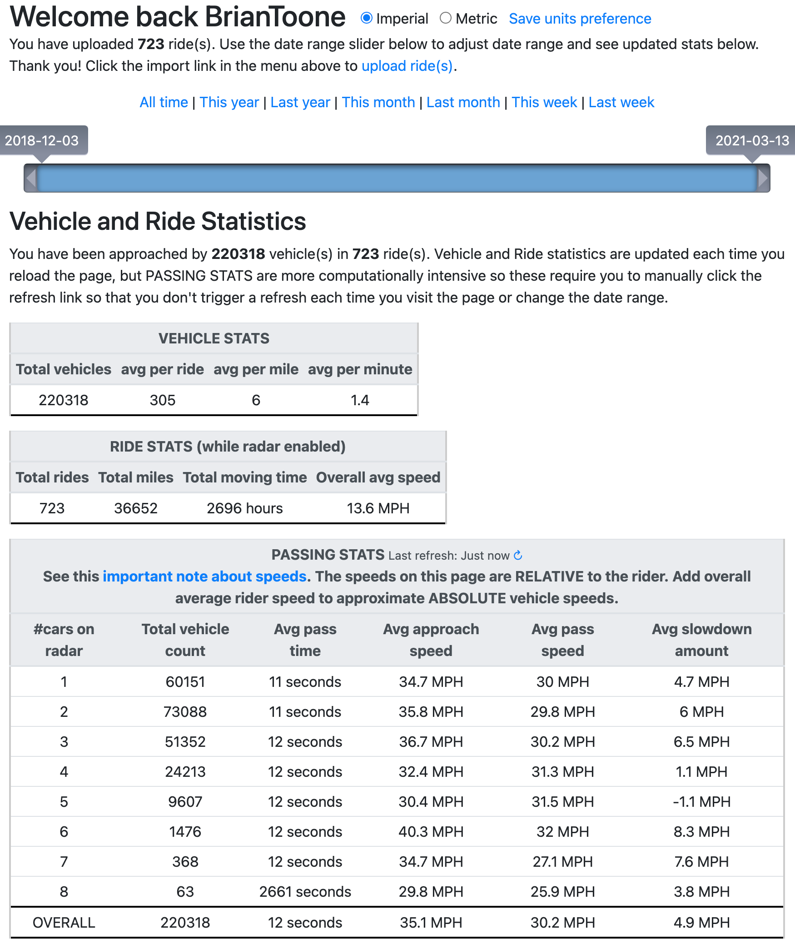
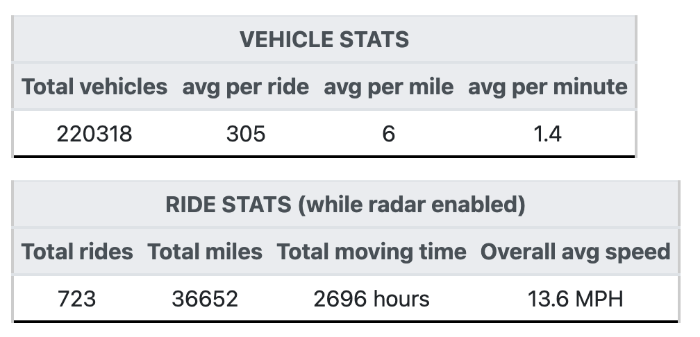
Summary stats
LOTS of data
My summary info
just from 12/2018
(2.25 years)

Slide 13
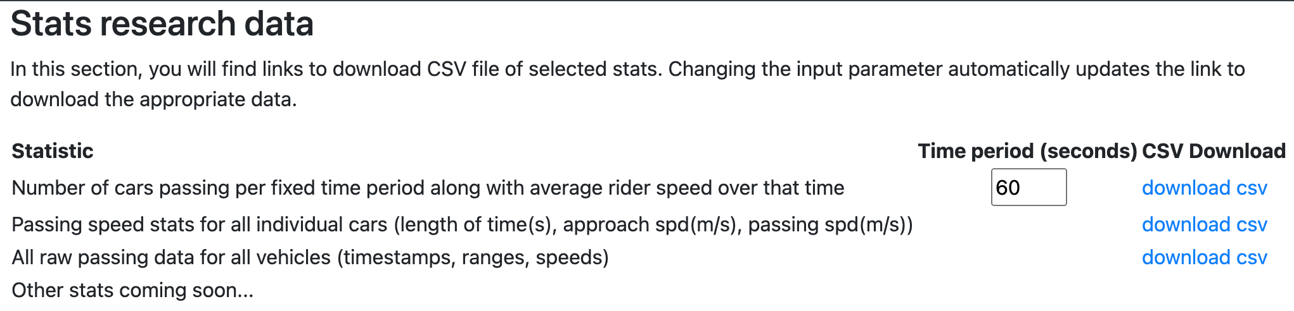
What about data for ALL riders collecting data (currently > 7000)?
Mingwei Sun - helping me analyze all the data from all the users
  R statistical analysis

Slide 14
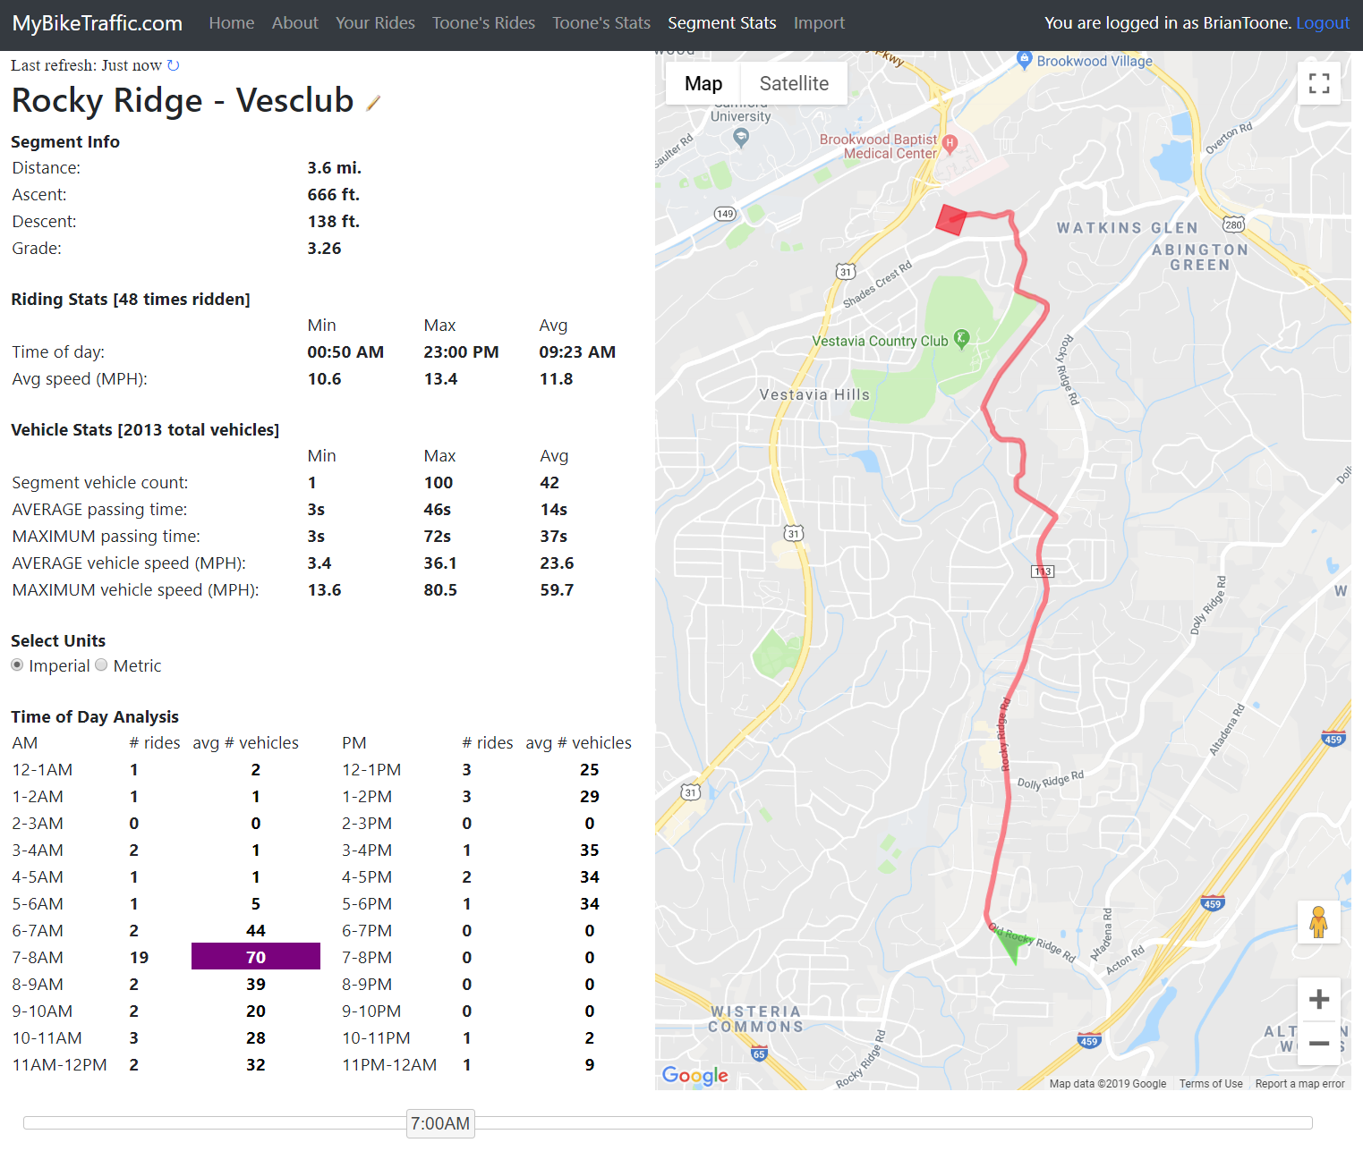
Segment stats
Time-of-day heat map
Slider loads hourly data

Slide 15
Motivated student wanted to help!
Sheng Gao
  Graduating senior from my Artificial Intelligence class
  Applying to grad schools and wanted more research experience
  Accepted to and started this semester at Columbia University (NY)!

Slide 16
Current work (Starting from Summer 2020)
ML automatic road classification
from rear-facing video
Tiny shoulder with no rumble strip
Medium shoulder with rumble strip

Slide 17
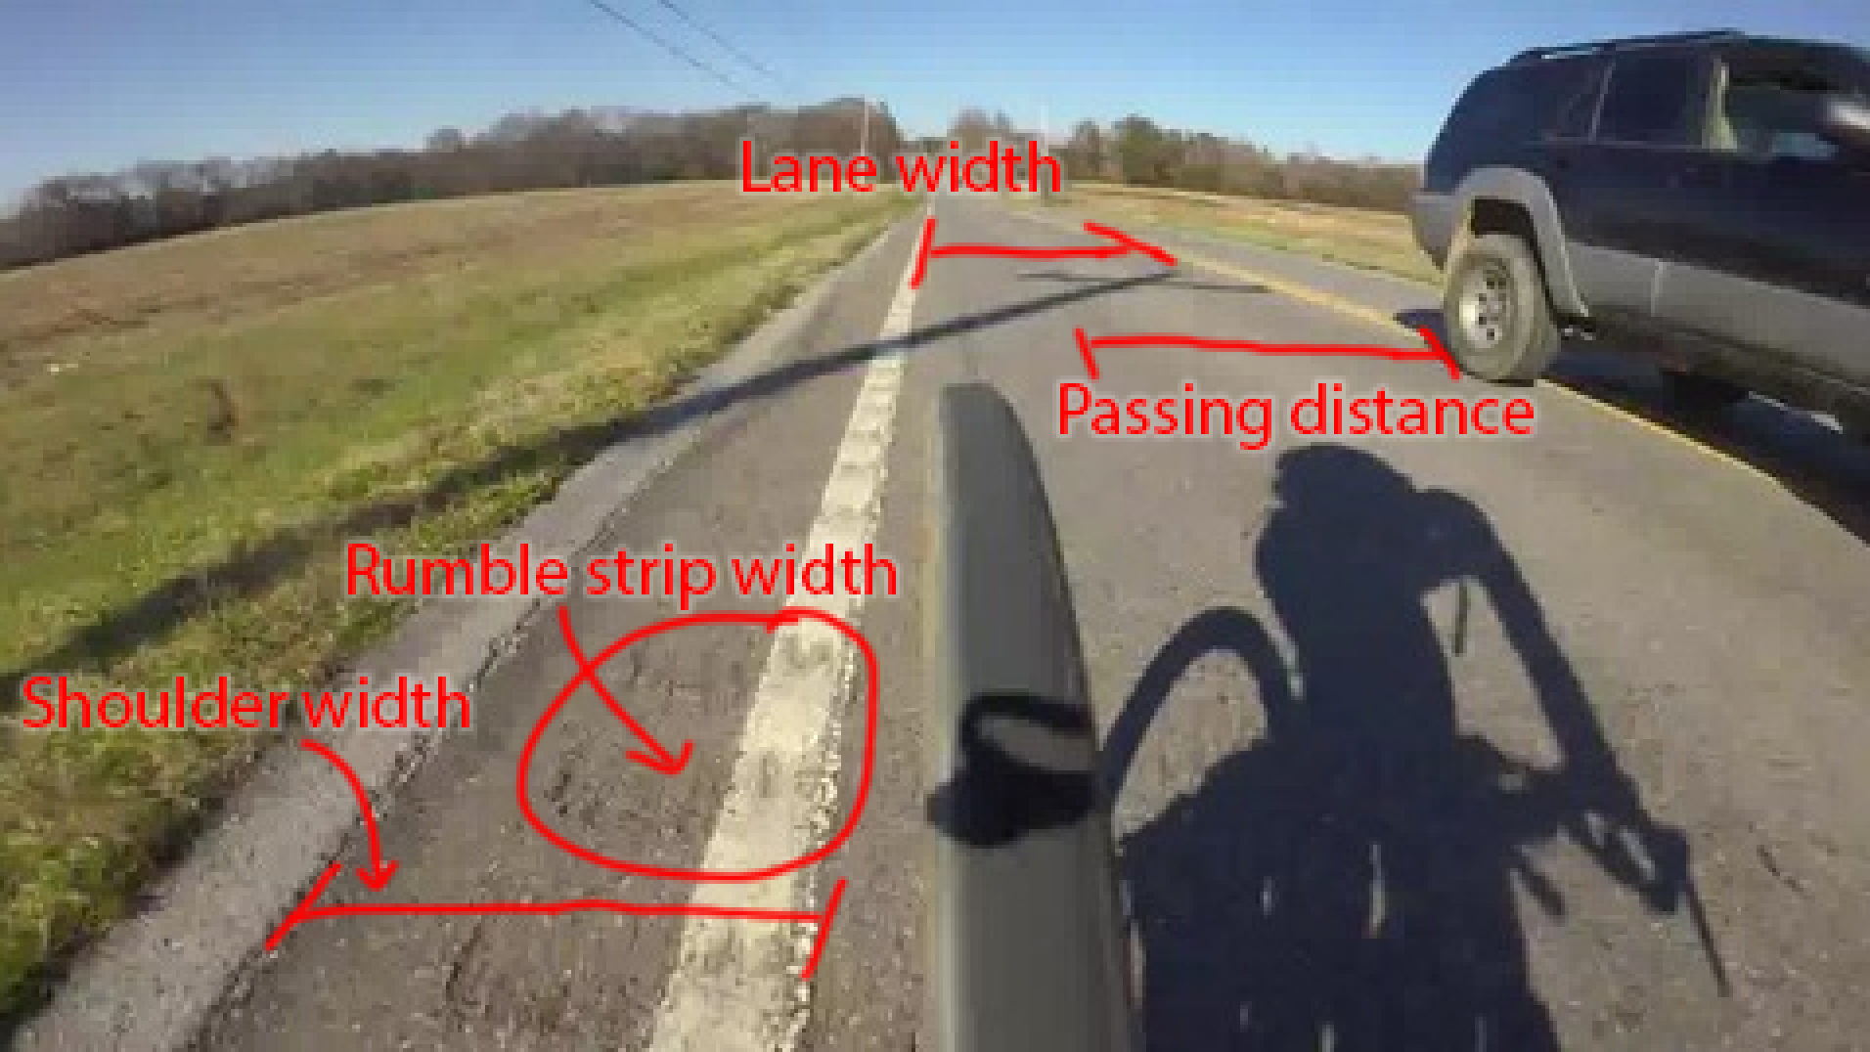
Current work (Starting from Summer 2020)
Additional ML task – object recognition and distance measurements as illustrated below

Slide 18
GOAL: establish correlation between road design and vehicle passing statistics
Current work (Starting from Summer 2020)
Road design classification
  Presence of bike lane, width of bike lane
  Presence of rumble strip
  Width of rumble strip
  Type of rumble strip (continuous or intermittent)
  Width of shoulder on either side of rumble strip
  Total width of shoulder
  Type of shoulder (smooth or rough)
  Total width of travel lane
  Number of travel lanes
  Passing/no passing zone
Vehicle passing statistics
  Count of vehicles that pass
  Average passing speed
  Average total time for vehicle to pass
  Slowdown (or speedup) amount
  Passing distance (lateral) between
  cyclist and vehicle

Slide 19
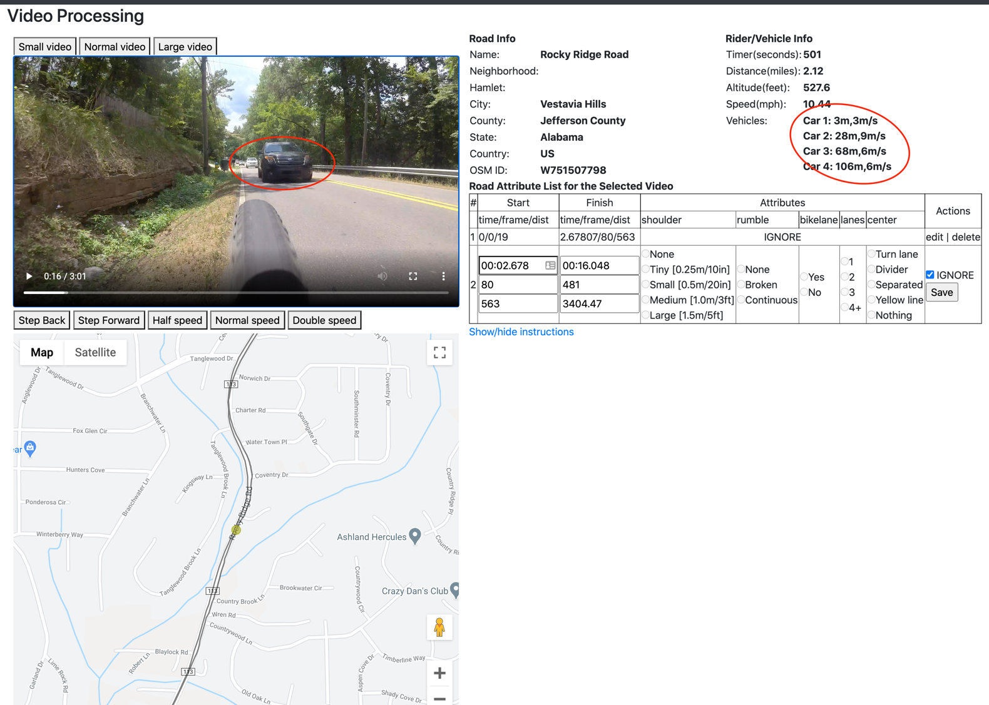

Slide 20
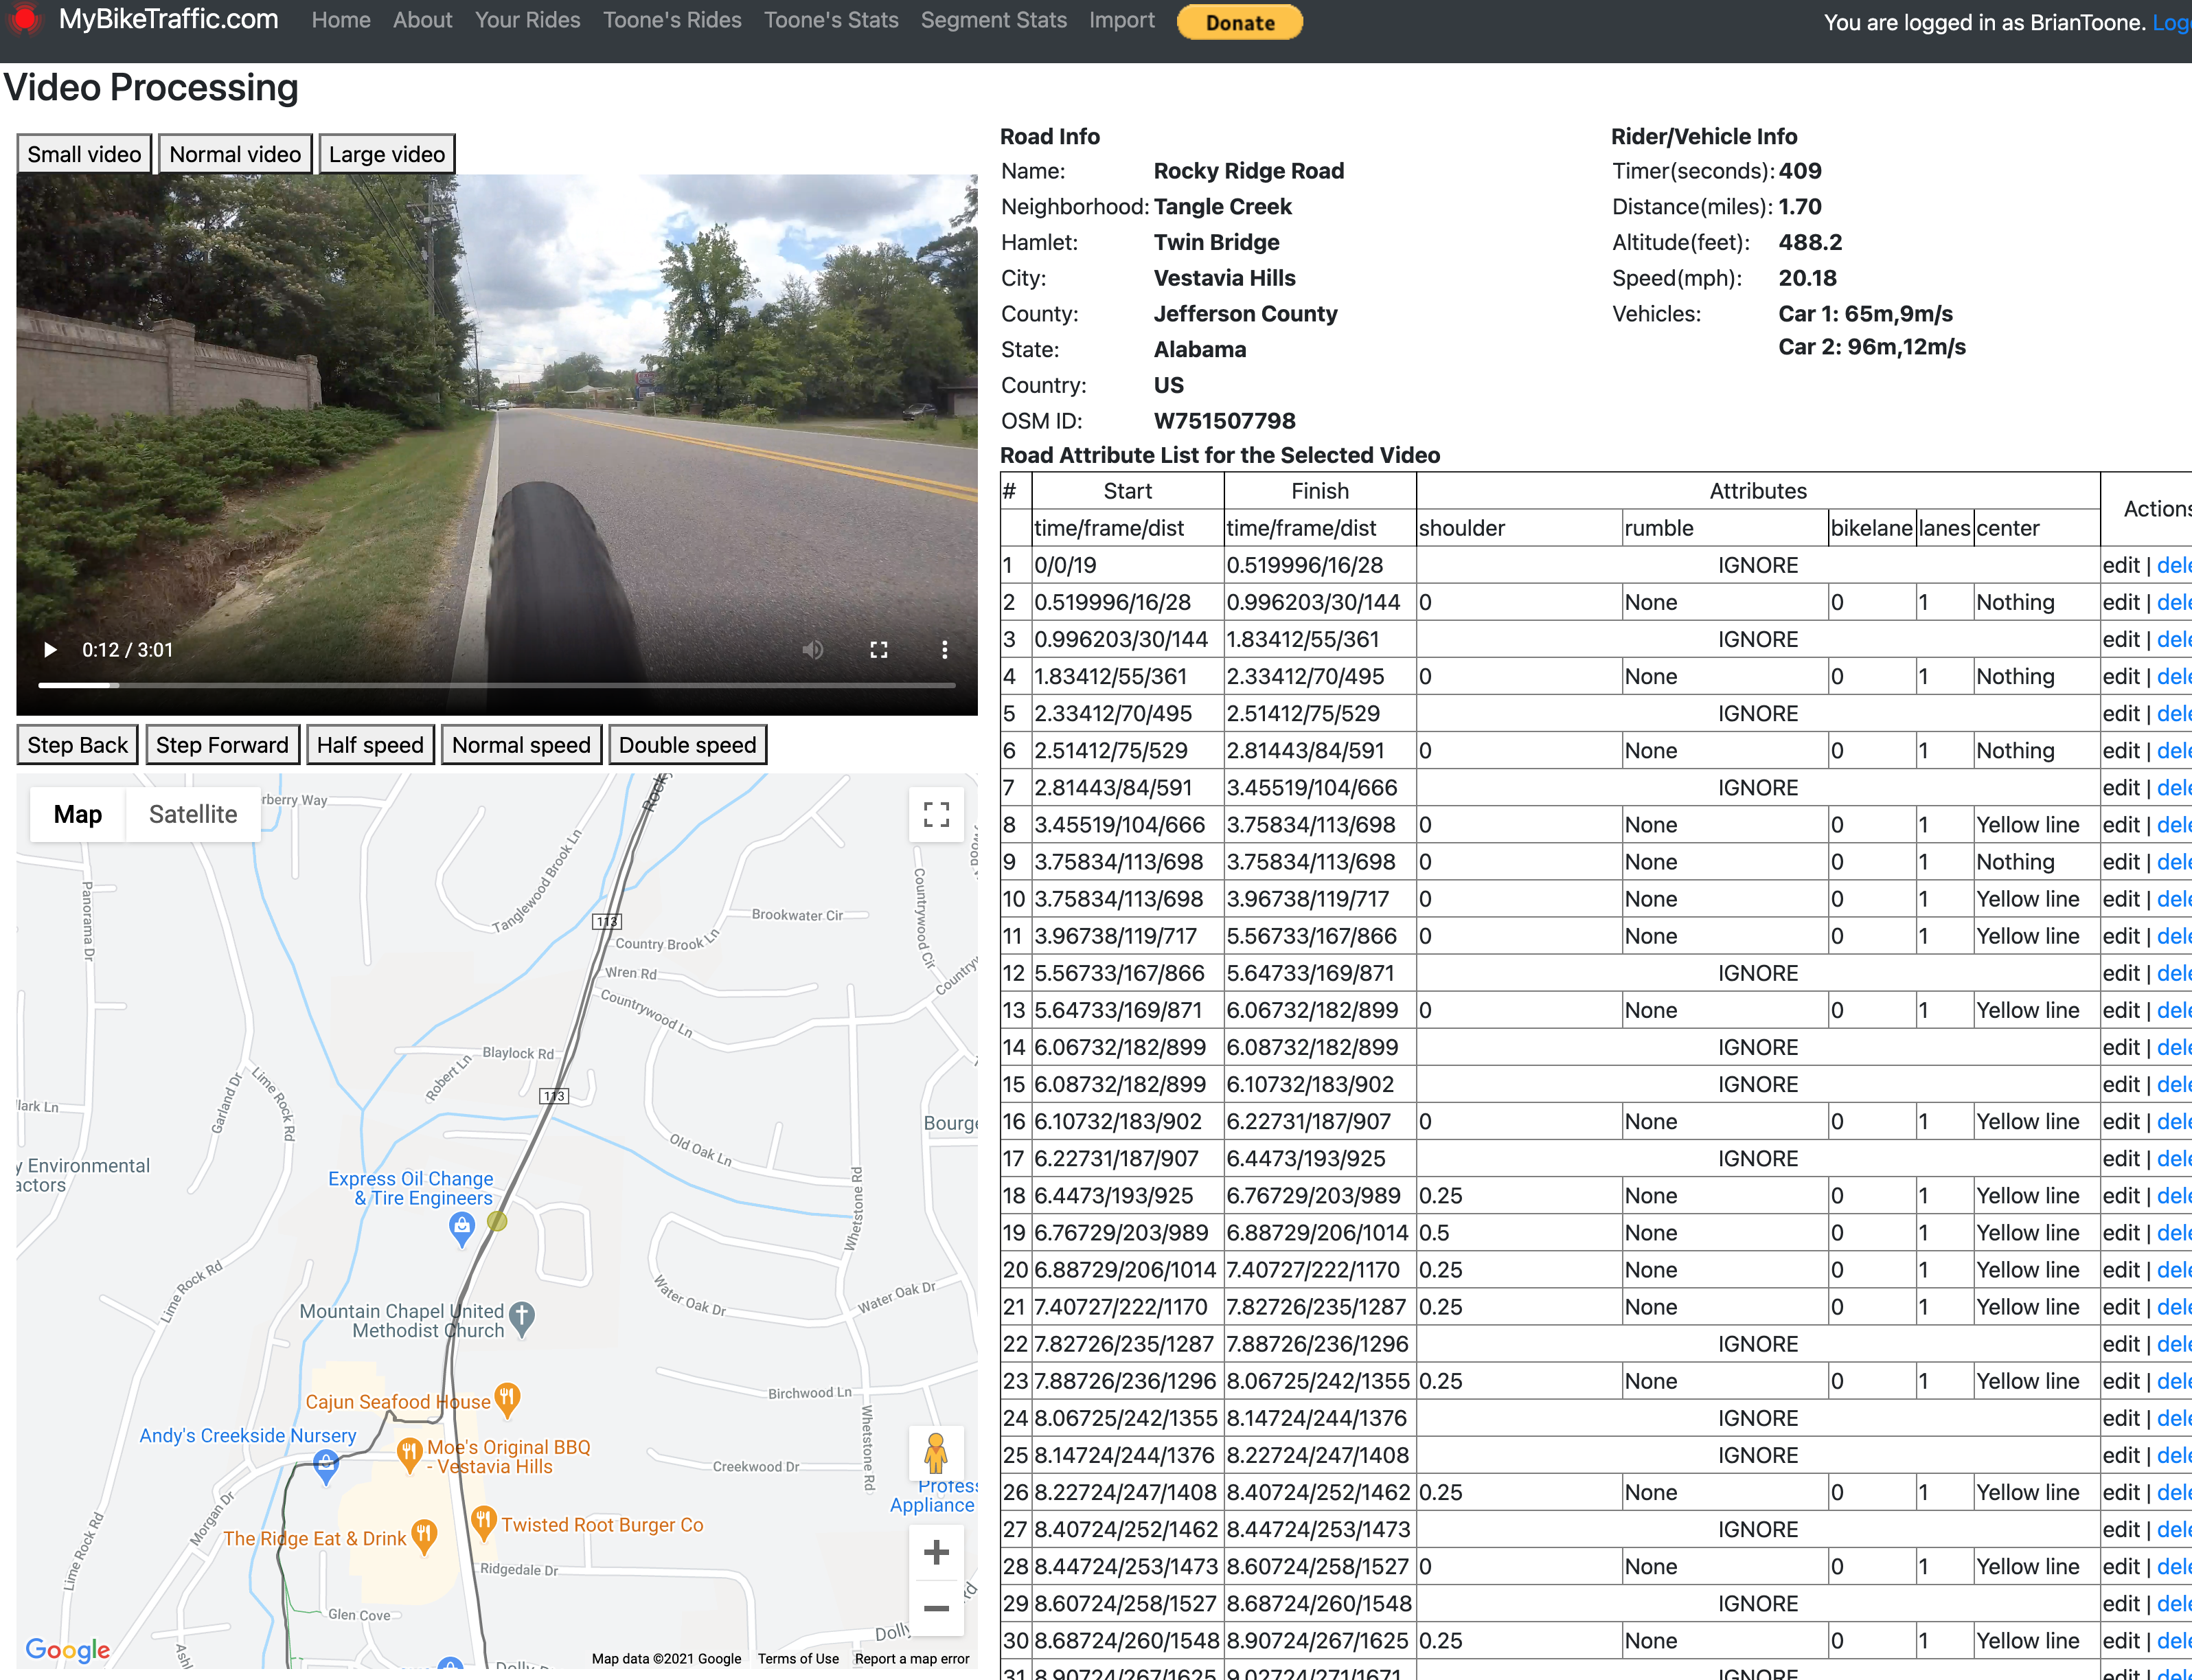
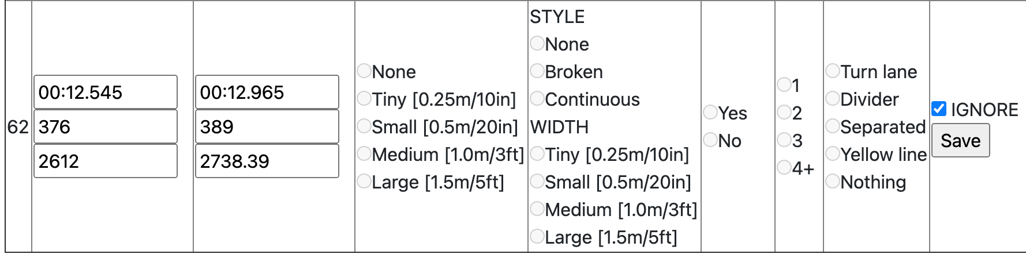

Slide 21
Expand framework
Current work (Starting from Summer 2020)
Currently 7000+ users of app collecting radar data
Very few users posting video data
  Tricky to post
  Very specific video camera and timelapse setup required
  Expand to make it easier to collect video data

Slide 22
Ultimate goal
Current work (Starting from Summer 2020)
Make impact on future road designs
  SAFER for cyclists
  FACILITATE vehicle passings
  (i.e., easier, quicker for vehicles to pass cyclists)
Reverse research
  Self-driving cars could pull from this data
  Object recognition from cyclist POV analogous to
  Self-driving car POV – extensive research already performed in this area (frequently proprietary info)

Slide 23
Thank you!
Brian Toone
brtoone@samford.edu
http://mybiketraffic.com
http://toonecycling.com

